Slide 1

CS 7123
DISCO: Distributed Inference with Sparse
Communications
Adiba Masud
PhD Student
Department of Computer Science
University of Texas at San Antonio
Date: 04/24/2025
Notes:
A
A
A
A
A
A
A
A
A

Slide 2
Outline
Introduction
Research Problem
Related work​
Methodology​
Experimental Results
Contributions​
Conclusion​ and Limitation
One UTSA Circle • San Antonio, Texas 78249
2

Slide 3
Outline
Introduction
Research Problem
Related work​
Methodology​
Experimental Results
Contributions​
Conclusion​ and Limitation
One UTSA Circle • San Antonio, Texas 78249
2

Slide 4
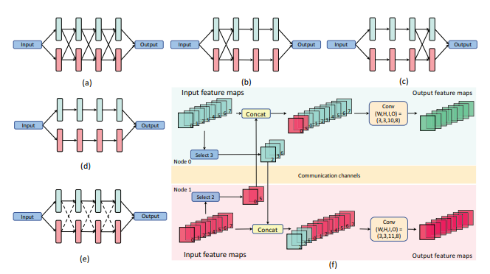
Introduction
Distributed inference allows splitting the model across multiple devices to reduce memory usage and improve speed [2].
This paper introduces DISCO — a novel framework for distributed inference with sparse communications — to significantly reduce inter-node communication while preserving model accuracy [3].
One UTSA Circle • San Antonio, Texas 78249
3

Slide 5
Introduction
Deep Neural Networks (DNNs) are powerful tools for real-world tasks like image classification and object detection [1].​
However, deploying large DNN models on resource-limited edge devices (e.g., ESP32, Raspberry Pi) [5] is challenging due to:​
High memory demands​
Intensive computations​
Strict latency constraints​
Distributed Inference solves this by spreading computation and memory across multiple devices [6] .​
But current methods suffer from:​
Heavy data communication within layers​
Latency bottlenecks, especially under low-bandwidth conditions
One UTSA Circle • San Antonio, Texas 78249
4

Slide 6
Importance of Distributed Inference
Why Do We Need Distributed Inference?
Memory Constraints
Lower Latency
Scalability
Collaborative Edge Intelligence
Energy Efficiency
How Partitioning Works in Distributed Inference?
Each device holds part of the input/output feature maps
Only a subset of features is shared between nodes
The rest is computed locally
Communication is sparse → reduces latency and bandwidth usage
One UTSA Circle • San Antonio, Texas 78249
6

Slide 7
Outline
Introduction
Research Problem
Related work​
Methodology​
Experimental Results
Contributions​
Conclusion​ and Limitation
One UTSA Circle • San Antonio, Texas 78249
2

Slide 8
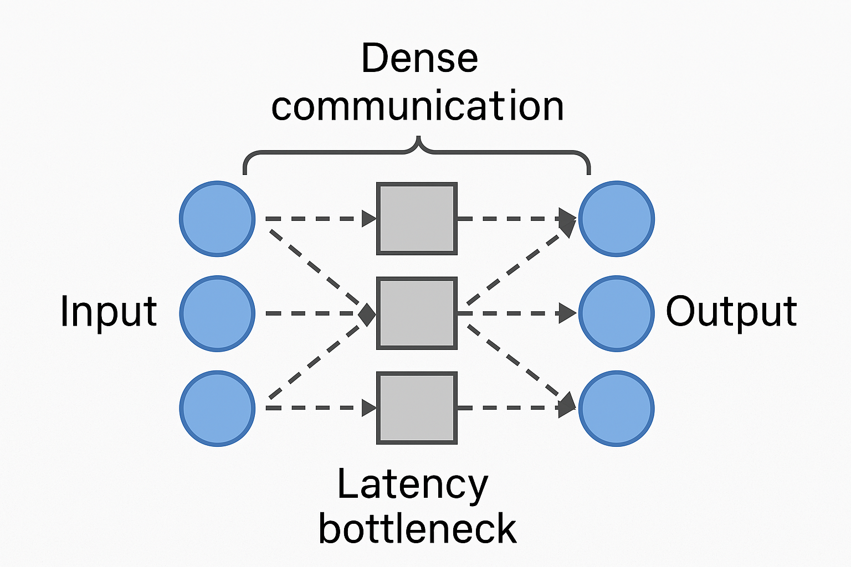
Research Problem
Distributed inference helps, but dense communication between nodes creates a latency bottleneck, especially with limited bandwidth.​
Traditional parallelism methods (data, pipeline, model) do not effectively reduce communication overhead during inference.
One UTSA Circle • San Antonio, Texas 78249
3

Slide 9
Outline
Introduction
Research Problem
Related work​
Methodology​
Experimental Results
Contributions​
Conclusion​ and Limitation
One UTSA Circle • San Antonio, Texas 78249
2

Slide 10
Literature Review: Device-Cloud Distributed Inference
Device-Cloud Architecture:
DNN models are split between edge devices (e.g., phones, sensors) and the cloud [7].
The splitting point determines how much computation is done locally vs. offloaded [7].
Limitations of These Approaches:
Only optimize a single communication point (the split) [8].
Ignore communication costs within cloud or device layers.
Do not address within-layer dependencies or fine-grained feature selection.
One UTSA Circle • San Antonio, Texas 78249
8

Slide 11
Literature Review: Branch-Based Parallelism
The DNN is split into independent branches, and each branch is assigned to a different device.
Advantages:
Minimal communication cost
Works well in low-bandwidth or fully decentralized environments [9]
Limitations of These Approaches:
No data sharing leads to accuracy drop
Cannot benefit from cross-device feature fusion
Reduces model's overall representational power [10]
One UTSA Circle • San Antonio, Texas 78249
8

Slide 12
Literature Review: System Scheduling Approaches
What They Do:
Focus on efficiently assigning inference tasks across multiple devices.
Optimize system-level performance without changing the DNN architecture [11].
Advantages:
Improve throughput and load balancing
Useful in heterogeneous device settings
Limitations
Work on fixed DNN structures
Don't explore architectural changes that reduce communication overhead [12] [20]
One UTSA Circle • San Antonio, Texas 78249
8

Slide 13
Literature Review: Distributed Training Methods
Speed up training of large DNNs by distributing data and computations across multiple devices.
Advantages:
Allows scalable training of large models
Optimizes training throughput [13] [19]
Limitations of These Approaches:
Targeted at training phase, not inference
Still requires dense communication, especially during backpropagation
Doesn’t address real-time latency or memory limits on edge devices [14]
One UTSA Circle • San Antonio, Texas 78249
8

Slide 14
Research Gap in Disco
High Communication Overhead
Existing model parallelism requires dense data exchange between nodes during inference, which creates a latency bottleneck, especially in low-bandwidth environments.
No Fine-Grained Feature Selection
Prior works do not optimize which features to transmit across devices — all features are typically shared, leading to inefficiency.
Architecture-Aware Communication Not Explored
Most prior approaches either focus on system scheduling or static partitioning, but do not jointly design the model and communication strategy for optimal performance.
Limited Support for Diverse Applications
Techniques are often evaluated on one task (e.g., classification), whereas there's a lack of a general framework that supports classification, detection, segmentation, and super-resolution efficiently.
One UTSA Circle • San Antonio, Texas 78249
13

Slide 15
Outline
Introduction
Research Problem
Related work​
Methodology​
Experimental Results
Contributions​
Conclusion​ and Limitation
One UTSA Circle • San Antonio, Texas 78249
2

Slide 16
Methodology: Disco Framework
Goal:
Enable distributed inference with sparse communication between nodes — maintaining accuracy while reducing latency and memory usage.
Within-Layer Model Parallelism
Sparse Communication Design
Feature Selection via Structured Weight Pruning
Final Result
Training Process
One UTSA Circle • San Antonio, Texas 78249
15

Slide 17
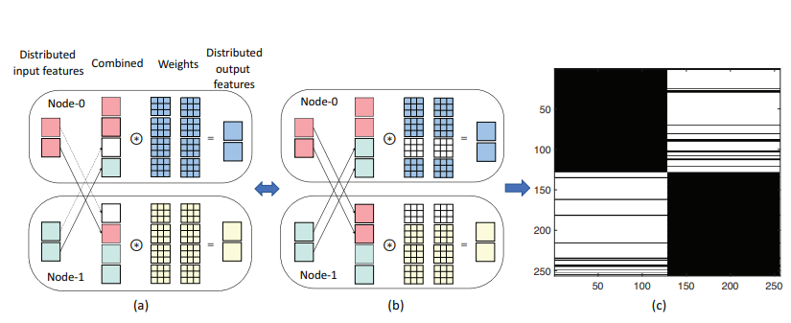
Methodology: Problem Statement
The input features are feature maps for convolutional neural networks (CNNs) and are neuron vectors/matrices for multi-layer perceptions (MLPs) and Transformers [16].
Figure 2: : Equivalence of feature selection and weight selection
One UTSA Circle • San Antonio, Texas 78249
15

Slide 18
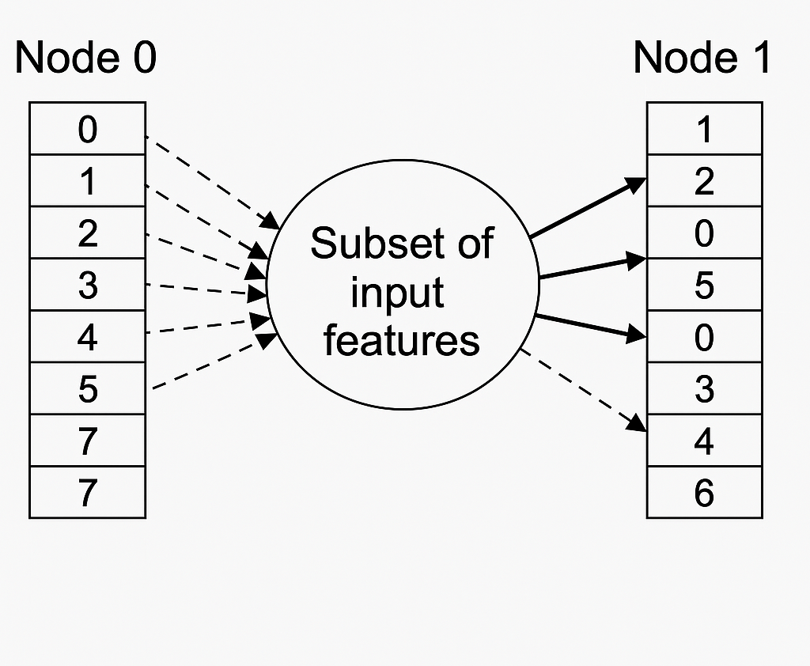
Methodology: Selection of the subset of input features to communicate
In distributed inference, each device (node) holds a subset of input features.
Not all features need to be shared — only the most important ones should be transmitted to reduce communication overhead [17].
How It Works:
Suppose each node holds 8 input features.
Instead of sending all 8 features to another node:
Node-0 sends only the top-3 most useful features (e.g., #2, #3, #6)
Node-1 sends only the top-2 most useful features (e.g., #0, #5)
One UTSA Circle • San Antonio, Texas 78249
15

Slide 19
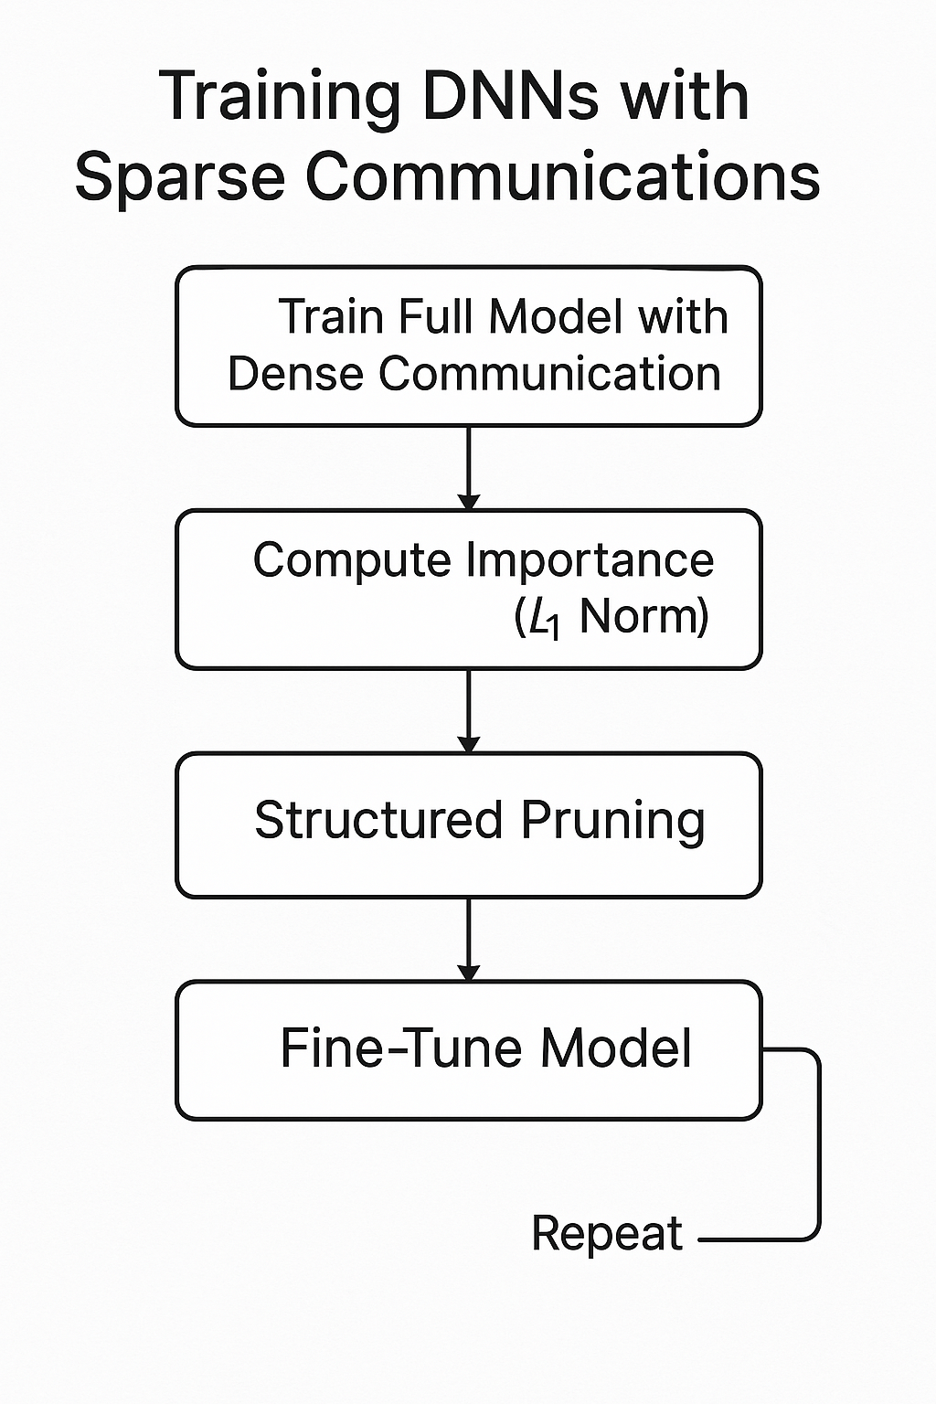
Methodology: Training DNNs with sparse communications
Goal
Learn a DNN with sparse inter-node communication [18]
Keep accuracy high while minimizing bandwidth
Step-by-Step Training Process in DISCO:
One UTSA Circle • San Antonio, Texas 78249
15

Slide 20
Outline
Introduction
Research Problem
Related work​
Methodology​
Experimental Results
Contributions​
Conclusion​ and Limitation
One UTSA Circle • San Antonio, Texas 78249
2

Slide 21
Experimental Design
DISCO was tested on a variety of computer vision tasks:
Image Classification → ResNet-50, DeiT
Object Detection → SSD300
Semantic Segmentation → DeepLabV3+
Super-Resolution → ESRGAN
Key Metrics
Scomm: Communication sparsity (e.g., 90% means 10% of features transmitted)
Scomp: Computation sparsity
Accuracy / mAP / mIoU / PSNR for each task
Outperforms:
Random sparse communication
Dense-then-split (SplitNet)
Split-then-aggregate (SplitNets)
One UTSA Circle • San Antonio, Texas 78249
28

Slide 22
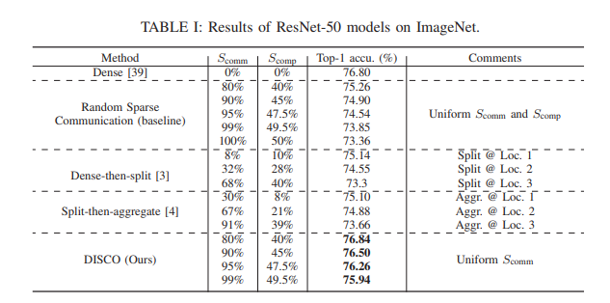
Result
ResNet-50 (ImageNet)
90% Scomm → Accuracy: 76.5% (vs. 73.8% for others)
Just 1% communication improves accuracy +2.6% over independent branches
One UTSA Circle • San Antonio, Texas 78249
28

Slide 23
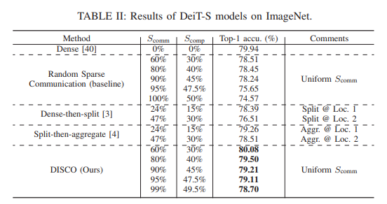
Result
DeiT-Small (Transformers)
60–80% Scomm → No accuracy loss
At 99% Scomm: Accuracy 78.7% vs. 74.6% (baseline)
One UTSA Circle • San Antonio, Texas 78249
28

Slide 24
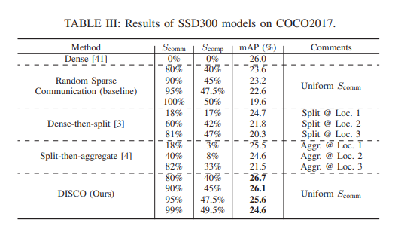
Result
SSD (Object Detection)
90% Scomm → mAP: 26.1%
1% communication improves mAP from 19.6% → 24.6%
One UTSA Circle • San Antonio, Texas 78249
28

Slide 25
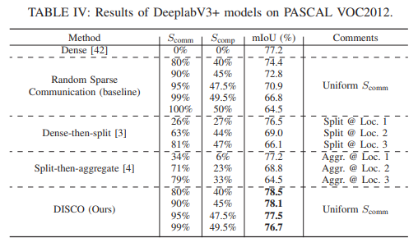
Result
DeepLabV3+ (Segmentation)
95% Scomm → mIoU: 77.5%
1% communication → +12.2% mIoU improvement
One UTSA Circle • San Antonio, Texas 78249
28

Slide 26
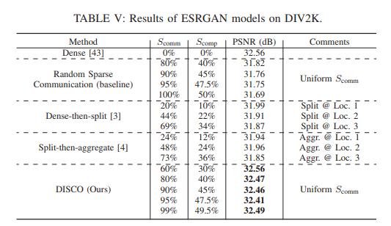
Result
ESRGAN (Super-Resolution)
90% Scomm → PSNR: 32.46dB (no quality loss)
+0.6dB gain over baselines with same bandwidth
One UTSA Circle • San Antonio, Texas 78249
28

Slide 27
Outline
Introduction
Research Problem
Related work​
Methodology​
Experimental Results
Contributions​
Conclusion​ and Limitation
One UTSA Circle • San Antonio, Texas 78249
2

Slide 28
Contributions
DISCO Framework for Distributed Inference,​
Conversion of Communication Selection to Weight Pruning,​
Significant Reduction in Communication with Minimal Accuracy Loss​
Demonstration of Model Parallelism Benefits​
Comparison with Existing Methods​
Experimental Validation Across Diverse DNN Architectures
One UTSA Circle • San Antonio, Texas 78249
32

Slide 29
Outline
Introduction
Research Problem
Related work​
Methodology​
Experimental Results
Contributions​
Conclusion​ and Limitation
One UTSA Circle • San Antonio, Texas 78249
2

Slide 30
Conclusion and Limitation
Key Findings:
Significant Communication Reduction
High Accuracy with Sparse Communication
Generalizable Framework
Joint Model-System Optimization
Structured Pruning Strategy
Limitations:
Only Tested on Two-Node Configurations
Assumes Synchronous Execution
Initial Dense Training Requirement
Hardware-Specific Optimizations Not Explored
One UTSA Circle • San Antonio, Texas 78249
32

Slide 31
References
1. R. Latha, G. R. R. Sreekanth, R. Suganthe, and R. E. Selvaraj, “A survey on the applications of deep neural networks,” in 2021 International Conference on Computer Communication and Informatics (ICCCI), 2021.2. Pottle J. Virtual reality and the transformation of medical education. Future healthcare journal. 2019 Oct 1;6(3):181-5.
2. J. Kim, Y. Park, G. Kim, and S. J. Hwang, “SplitNet: Learning to semantically split deep networks for parameter reduction and model parallelization,” in Proceedings of the 34th International Conference on Machine Learning, 2017, pp. 1866–1874.
3. X. Dong, Z. Li, M. Li, Z. Qu, B. D. Salvo, C. Liu, and H.-T. Kung, “SplitNets: Designing neural architectures for efficient distributed computing on head-mounted systems,” in Proceedings of the IEEE Conference on Computer Vision and Pattern Recognition (CVPR), 2022.
4. R. Hadidi, B. Asgari, J. Cao, Y. Bae, D. E. Shim, H. Kim, S.-K. Lim, M. S. Ryoo, and H. Kim, “LCP: A low-communication parallelization method for fast neural network inference in image recognition,” arXiv preprint arXiv:2003.06464, 2020.
5. A. E. Eshratifar, M. S. Abrishami, and M. Pedram, “JointDNN: An efficient training and inference engine for intelligent mobile cloud computing services,” IEEE Transactions on Mobile Computing, vol. 20, no. 2, pp. 565–576, 2021
6. H.-J. Jeong, I. Jeong, H.-J. Lee, and S.-M. Moon, “Computation offloading for machine learning web apps in the edge server environment,” in 2018 IEEE 38th International Conference on Distributed Computing Systems (ICDCS), 2018, pp. 1492–1499
7. D. J. Pagliari, R. Chiaro, E. Macii, and M. Poncino, “Crime: Inputdependent collaborative inference for recurrent neural networks,” IEEE Transactions on Computers, vol. 70, no. 10, pp. 1626–1639, 2021.
8. D. Hu and B. Krishnamachari, “Fast and accurate streaming cnn inference via communication compression on the edge,” in 2020 IEEE/ACM Fifth International Conference on Internet-of-Things Design and Implementation (IoTDI), 2020, pp. 157–163.
9. S. Jung and H.-W. Lee, “Optimization framework for splitting DNN inference jobs over computing networks,” 2021.
10. A. Parthasarathy and B. Krishnamachari, “Defer: Distributed edge inference for deep neural networks,” in 2022 14th International Conference on COMmunication Systems and NETworkS (COMSNETS), 2022, pp. 749–753.
11. Z. Zhao, K. M. Barijough, and A. Gerstlauer, “Deepthings: Distributed adaptive deep learning inference on resource-constrained iot edge clusters,” IEEE Transactions on Computer-Aided Design of Integrated Circuits and Systems, vol. 37, no. 11, pp. 2348–2359, 2018.
12. Keshavarz B, Hecht H. Validating an efficient method to quantify motion sickness. Human factors. 2011 Aug;53(4):415-26.
13. S. Teerapittayanon, B. McDanel, and H. Kung, “Distributed deep neural networks over the cloud, the edge and end devices,” in 2017 IEEE 37th International Conference on Distributed Computing Systems (ICDCS), 2017, pp. 328–339.
One UTSA Circle • San Antonio, Texas 78249
36

Slide 32
References
14. T. Mohammed, C. Joe-Wong, R. Babbar, and M. D. Francesco, “Distributed inference acceleration with adaptive DNN partitioning and offloading,” in IEEE INFOCOM 2020 - IEEE Conference on Computer Communications, 2020, pp. 854–863
15. Q. Li, L. Huang, Z. Tong, T.-T. Du, J. Zhang, and S.-C. Wang, “Dissec: A distributed deep neural network inference scheduling strategy for edge clusters,” Neurocomputing, vol. 500, pp. 449–460, 2022.
16. C. Hu and B. Li, “Distributed inference with deep learning models across heterogeneous edge devices,” in IEEE INFOCOM 2022 - IEEE Conference on Computer Communications, 2022, pp. 330–339
17. X. Hou, Y. Guan, T. Han, and N. Zhang, “Distredge: Speeding up convolutional neural network inference on distributed edge devices,” in 2022 IEEE International Parallel and Distributed Processing Symposium (IPDPS), 2022, pp. 1097–1107
18. A. L. Gaunt, M. A. Johnson, M. Riechert, D. Tarlow, R. Tomioka, D. Vytiniotis, and S. Webster, “AMPNet: Asynchronous model-parallel training for dynamic neural networks,” arXiv preprint arXiv:1705.09786, 2017.
19. J. Giacomoni, T. Moseley, and M. Vachharajani, “Fastforward for efficient pipeline parallelism: A cache-optimized concurrent lock-free queue.” Association for Computing Machinery, 2008, p. 43–52.
20. L. Guan, W. Yin, D. Li, and X. Lu, “XPipe: Efficient pipeline model parallelism for multi-GPU DNN training,” arXiv preprint arXiv:1911.04610, 2019.
One UTSA Circle • San Antonio, Texas 78249
37

Slide 33

Thank you !
One UTSA Circle • San Antonio, Texas 78249
38

